Slide 1
Temperature controller
Didi Chi
Shiyu Zhang

Slide 2

Overall
Range: 5-45°C
Heat up to maximum from room temperature: 40S
Cool down from 40 to 5 degree: 2 min
Accuracy: 0.01°C
Application: polymerase chain reaction: multiple heating cooling cycle.

Slide 3
User Interface
Local input output: the nob(potential meter) and liquid crystal display
Remote output(cloud): Http transfer to dweet.io

Slide 4
Signal conditioning
Thermistor: temperature VS resistance
NE555 : resistance VS frequency
Result : temperature VS frequency
Why?

Slide 5
Signal conditioning

Slide 6
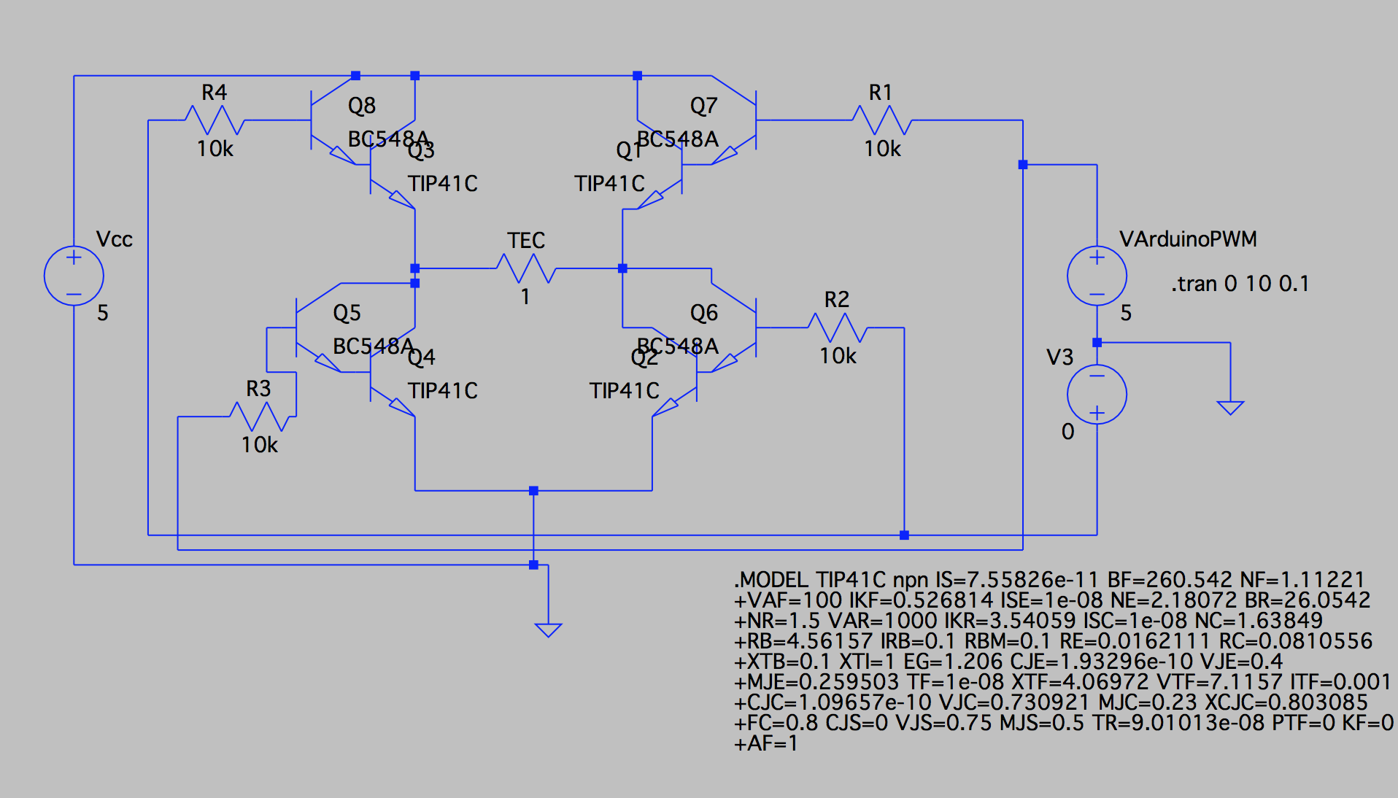
Actuator: H-Bridge
NPN Transistors being used:
TIP41C and BC548B

Slide 7
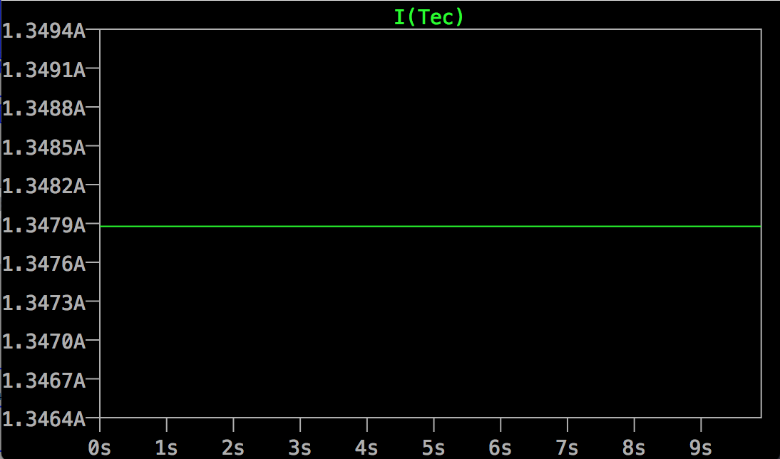
Simulation Result

Slide 8

Details about the circuit
Two Vin: One input for controlling the heating TEC and the other end for controlling cooling TEC
Providing power for the H-bridge:
provided by DC power Supply with 5V and 2A current limit

Slide 9



Details about the circuit
Cooling
Heating
Cooling
Heating

Slide 10
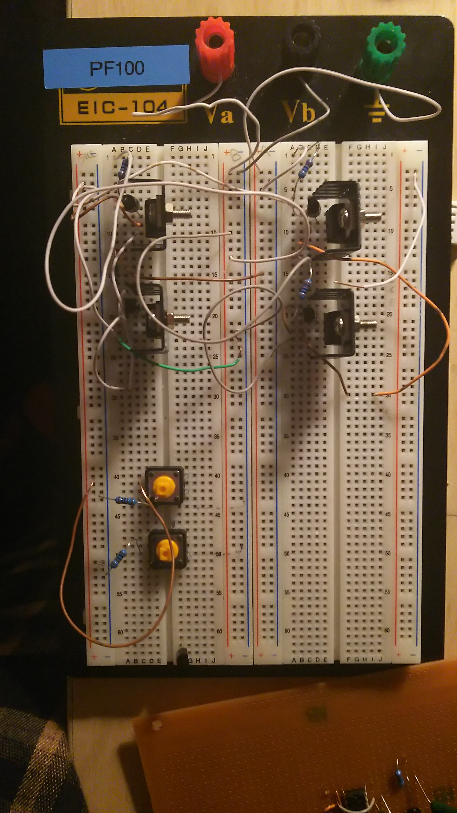
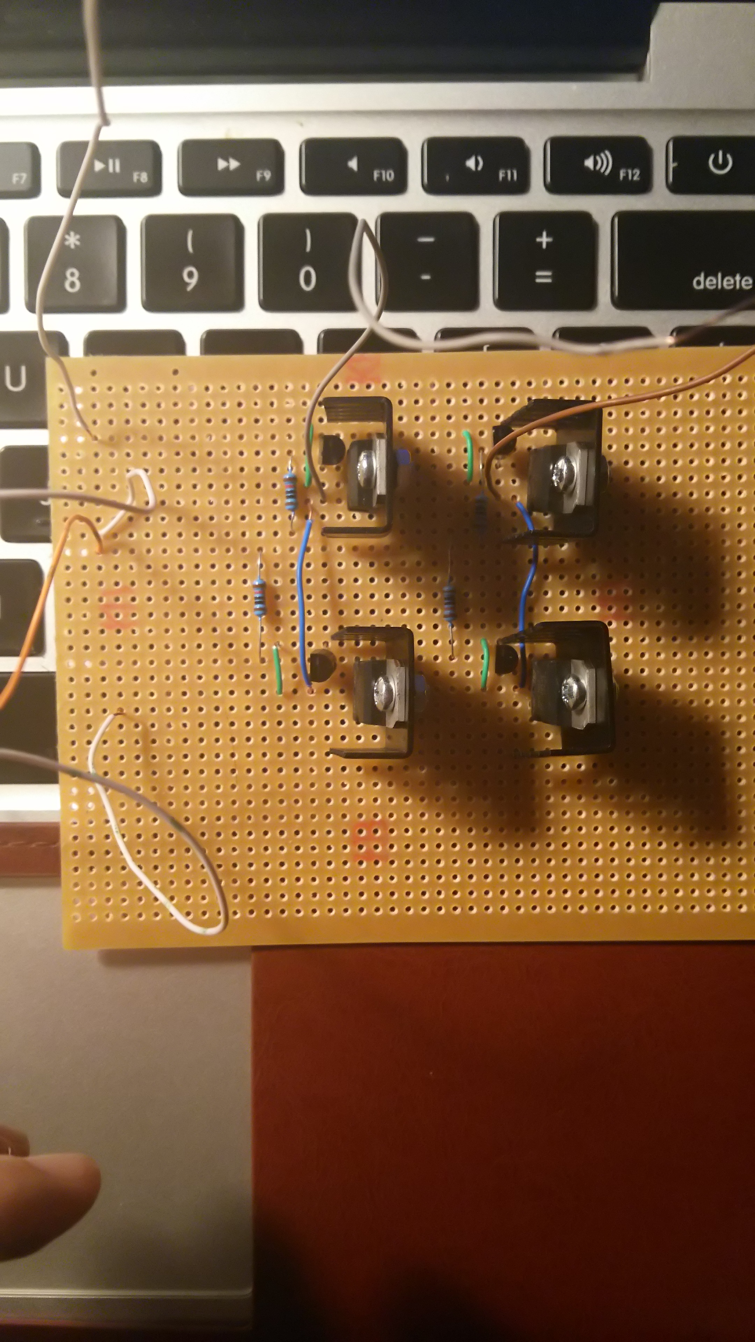
Result from breadborad: 1.3A
Vcc 5V power supply
Heating
Cooling
Common Ground
Result from veroboard: 1A, 1.7A

Slide 11
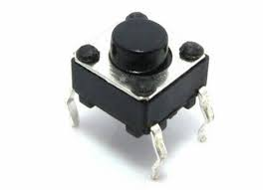
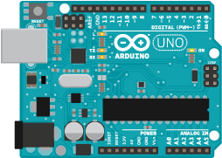
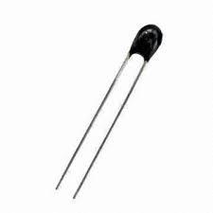
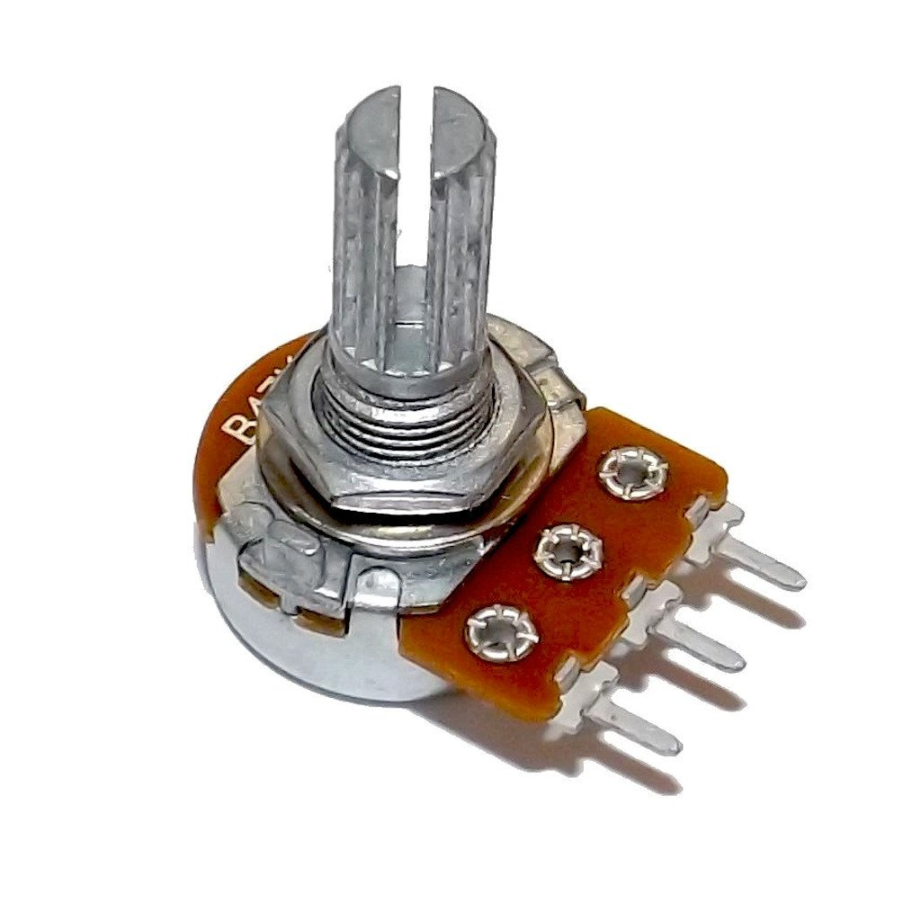
Control Signal
Heat/Cool mode
Cool Mode
OR
Heat Mode
if > 0
HEAT ON
OR
-
COOL ON
Sensor
User Input
else
Absolute difference
Do Nothing
Bang Bang Control

Slide 12
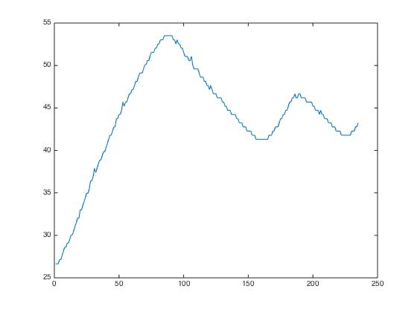
Result
Why we did not use PID Control
Advantages and drawbacks of bang bang control
time(with one step of 0.5s long) = 1 minute 40 seconds

